Slide 1
Falcon - Quadrotor Flight Control System
Sarah Cooley
Torben Rasmussen
Scott Rosenbalm
Joey Tomlinson

Slide 2
Our Project
IARC Competition
Autonomously navigate a building
Find and retrieve USB flash drive
We are making the flight controller for this vehicle.
Stability control
Dead reckoning

Slide 3
Video
http://www.youtube.com/watch?v=ulaZ91LmbfA

Slide 4
Motivation For a new Design
Create an integrated solution
Increase robustness
Increase performance
Reduce cost

Slide 5
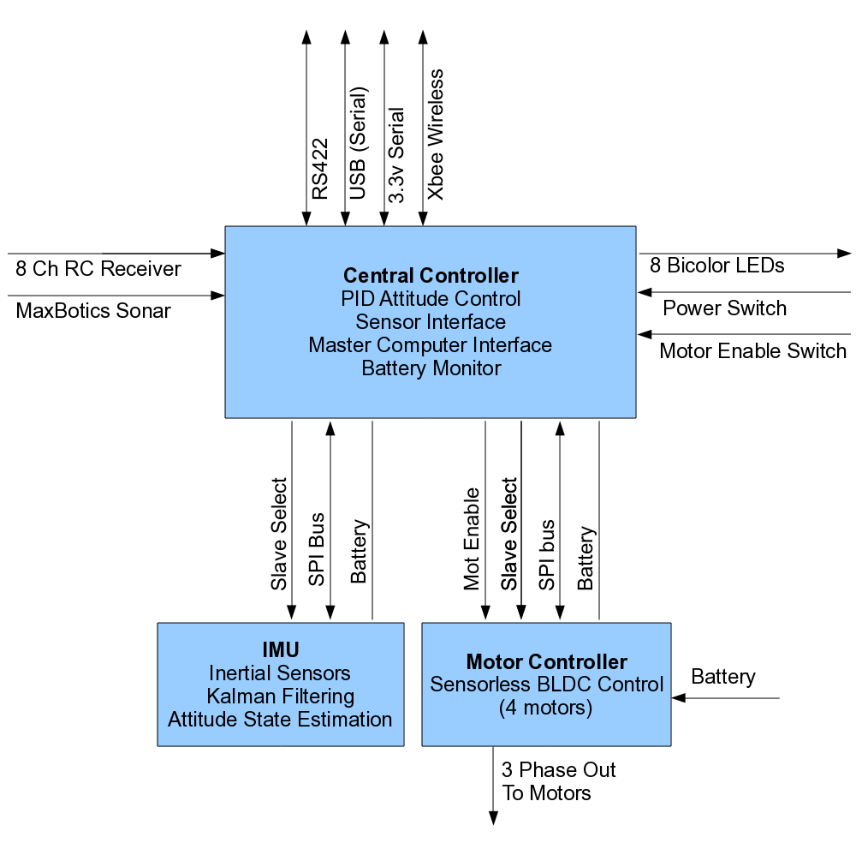
High Level Block Diagram

Slide 6
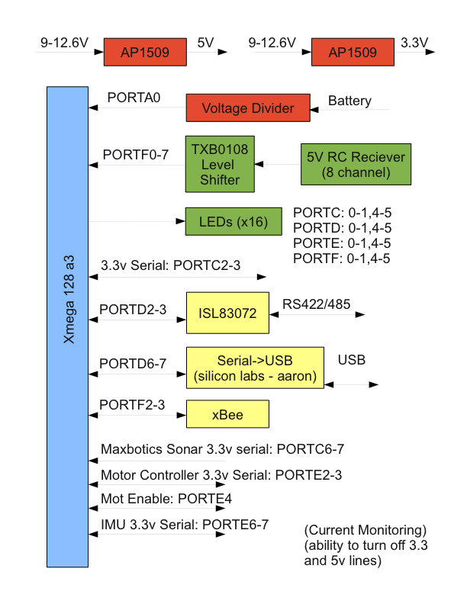
fcu

Slide 7
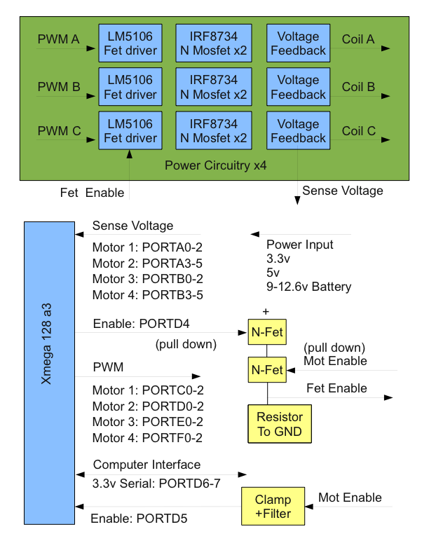
mcu

Slide 8
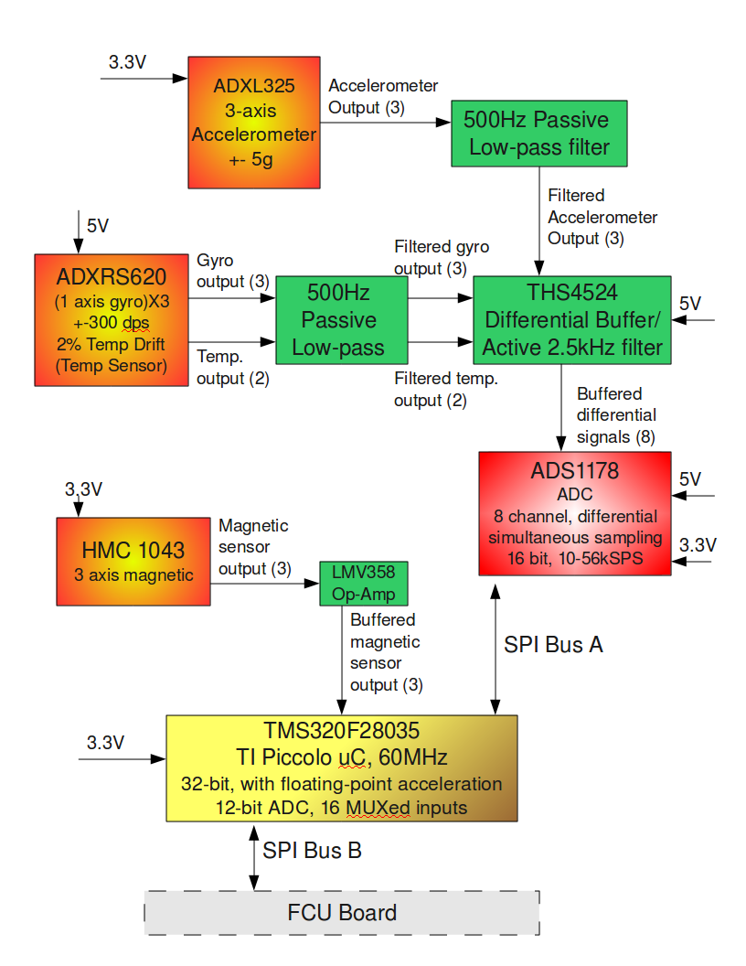
imu

Slide 9
Control Systems
Kalman Filtering
PID
Sensorless BLDC Motor Controllers
Environment
Control Input

Slide 10

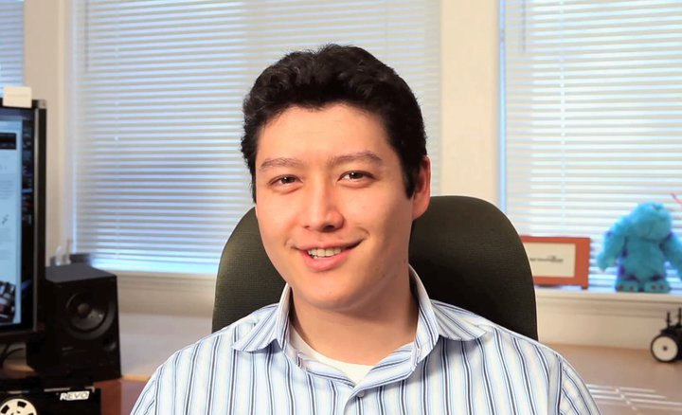
Sponsors
Aaron Moore

Slide 11
Any questions?

